Slide 1
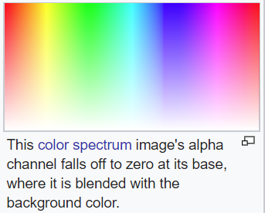
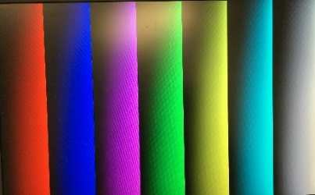
Lecture 10-2 Zybo Base System Design Demo and Color Generation
References
Zybo Base System Design Demo
axi_vdma – Video DMA Module
axi_dispctrl – VGA and HDMI Display Module
VGA Analog Color Generation on Zybo
Bitmap Pixel Frame
DISPLAYDEMO_PATTERN_1:
image generation
Tweetable Mathematical Art Design Competition
Other images from students at HUST

Slide 2
References
Vivado Design Suite, AXI Reference Guide UG1037 (v3.0) June 24, 2015, Xilinx
AXI Video Direct Memory Access v6.2, LogiCORE IP Product Guide, Vivado Design Suite, PG020, November 18, 2015, Xilinx
AXI DMA v7.1 LogiCORE IP Product Guide, Vivado Design Suite, PG021, November 18, 2015, Xilinx
AXI4-Stream Video IP and System Design Guide, UG934 (v2.2) April 6, 2016, Xilinx
Getting Started with AXI4-Stream Interface in Zynq Workflow, Mathworks, http://www.mathworks.com/help/hdlcoder/examples/getting-started-with-axi4-stream-interface-in-zynq-workflow.html?s_tid=gn_loc_drop.
axi stream interface by Mohammadsadegh Sadri, http://www.googoolia.com/wp/2014/04/12/lesson-3-axi-stream-interface/.
Zybo Base System Design, Digilient, https://reference.digilentinc.com/zybo:zybo

Slide 3
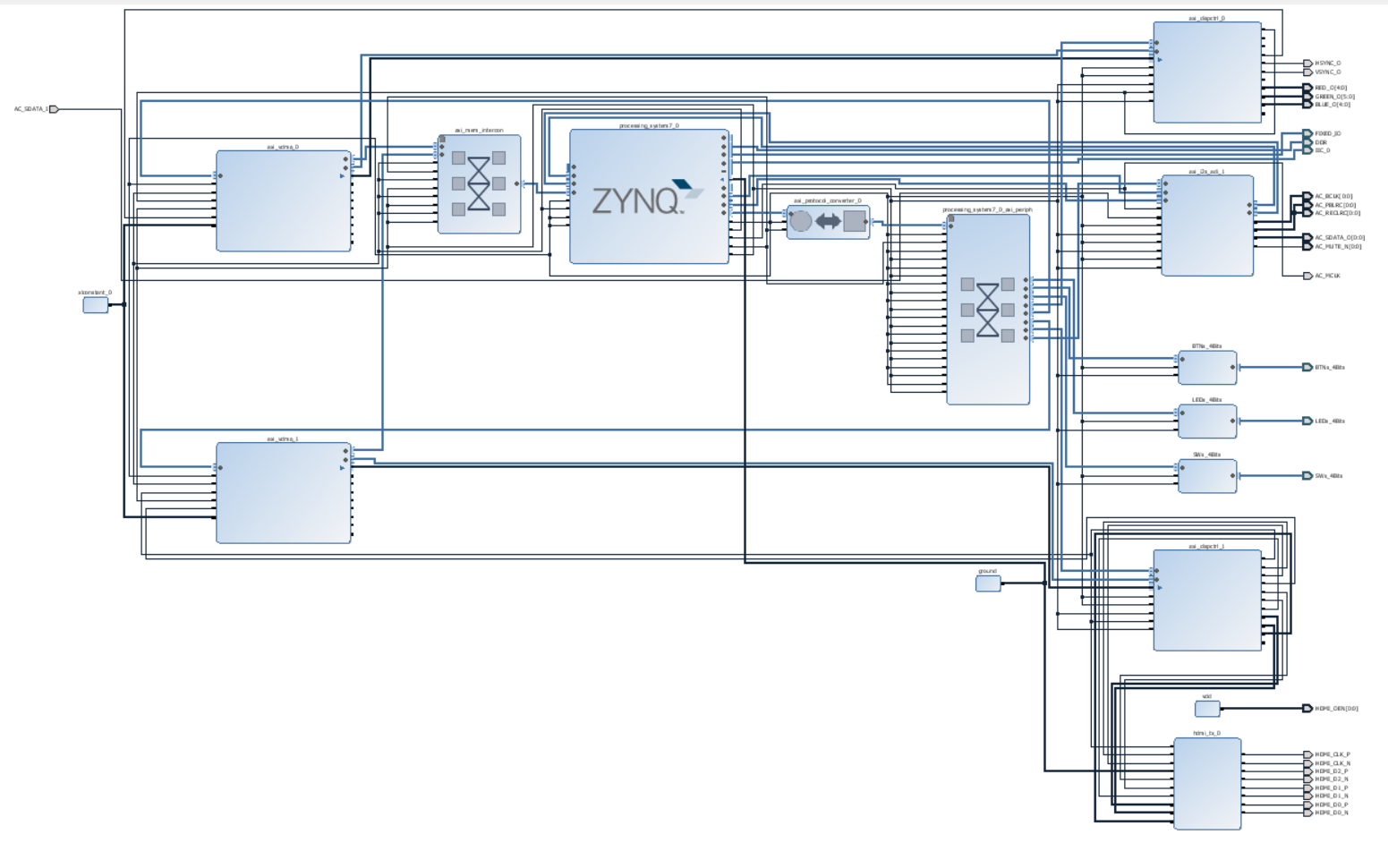
Zybo Base System Design Block Diagram

Slide 4
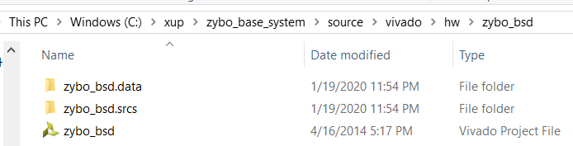
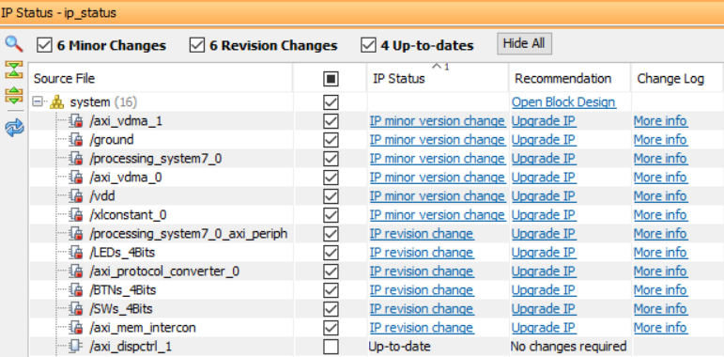
Zybo Base System Design
Available from Digilent:
https://reference.digilentinc.com/reference/programmable-logic/zybo/start: Additional Resources-> Zybo Base System Design(Deprecated)
zybo_bsd project can be found and opened in this folder.
Convert zybo_bsd project to run with Version 2015 of Vivado.
Many IP need to be upgraded

Slide 5
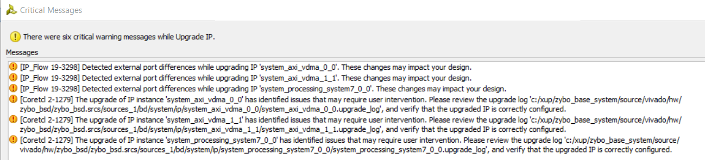
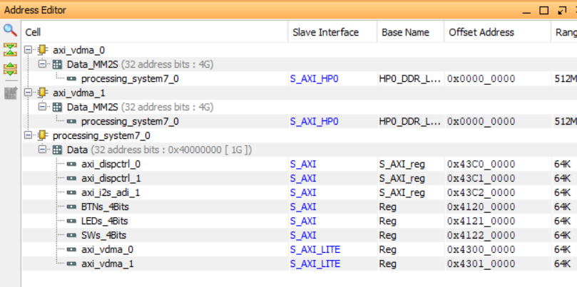
Zybo Base System Design
. Critical warnings are generated after IP upgrading.
Synthesis can be carried with these warnings and address assignment

Slide 6
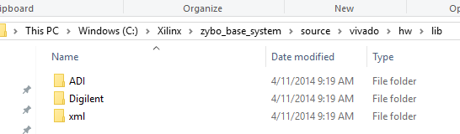
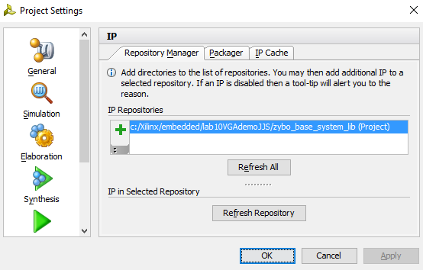
Zybo Base System Design Lib
Zybo base design lib folder contains display module axi_dispctrl_1.0.
To add this lib folder to your Vivado project, copy the lib folder to your Vivado project folder and add this lib to your IP repository.
The lib will be part of this project even if the project folder is moved.

Slide 7
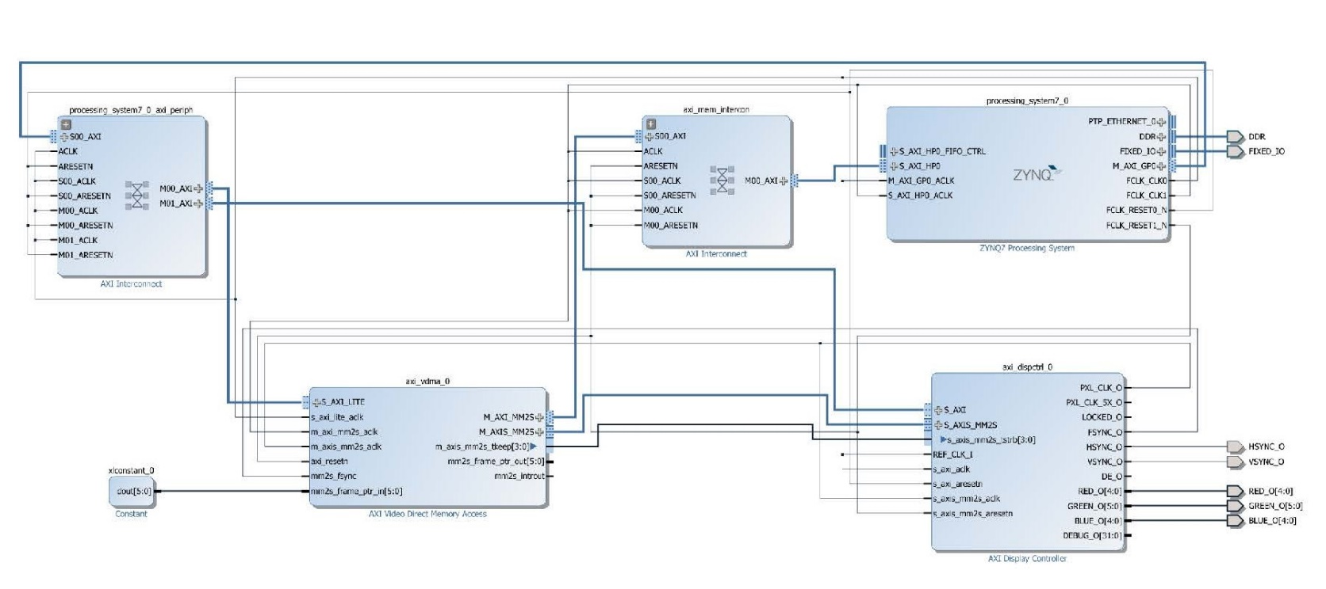
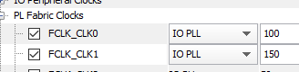
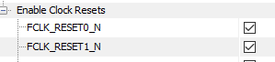
A Simplified Zybo Base System Design Needs to Be Made
Zynq, ARM
axi_vdma_0, AXI Video Direct Memory Access, Xilinx
axi_dspctrl_0, AXI VGA Display Controller, Digilent
AXI General Purpose Port, Synchronization Message Interface
AXI high Performance Port, Memory Interface
Two PL clocks and resets:
FCLK_CLK0 (100MHz) and FCLK_RESET0_N for normal blocks
FCLK_CLK1 (150MHz) and FCLK_RESET1_N for DMA and HP interfaces

Slide 8
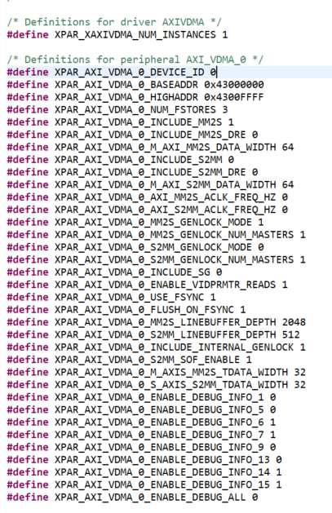
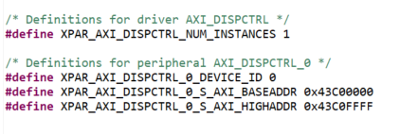
vdma and vga display controllers in xparameters.h

Slide 9
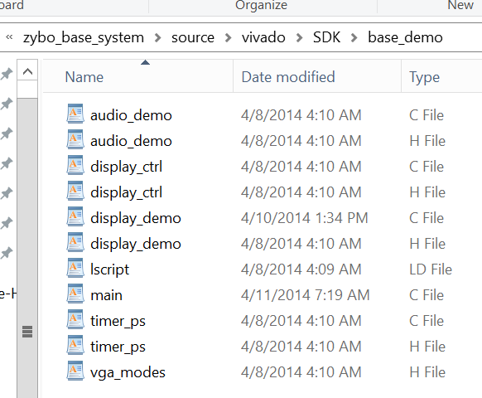
Zybo Base System Design Demo Programs
Base_demo folder of the zybo base system design contains all source files to demonstrate the block design. (zybo_base_system\source\vivado\SDK)
These source programs can be compiled to run under the zybo base system block design.
These source programs can be analyzed to understand vga and hdmi displays as well as audio play.

Slide 10
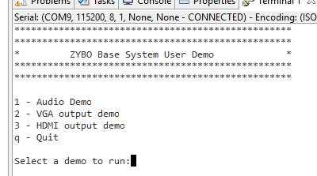
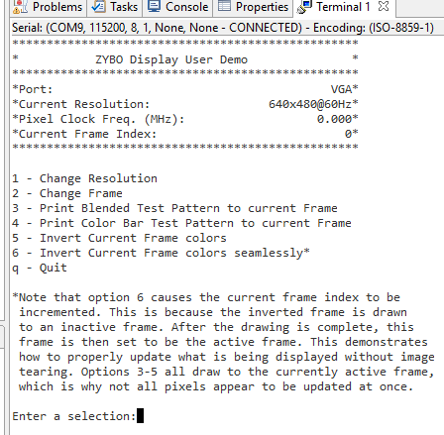
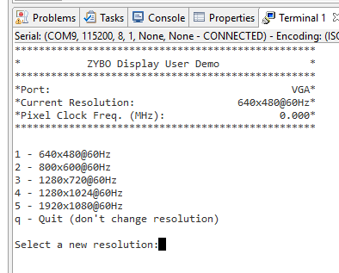
Zybo Base System Design Demo

Slide 11
Zybo Base System Design Example
main
DisplayDemoInitialize
DisplayInitialize
DisplayStart
MainDemoPrintMenu();
DisplayDemoPrintTest
DISPLAYDEMO_PATTERN_1
DisplayDemoRun VGA
Display Options
quit
No
Yes

Slide 12
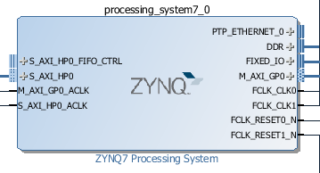
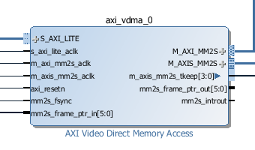
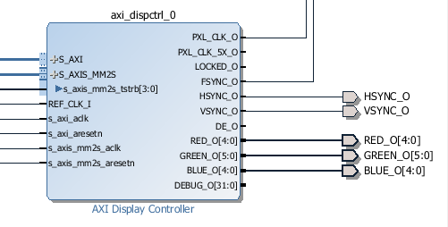
Zybo Base System Design: Frame Buffers and Hardware Connections
DisplayDemoInitialize(&vgaCtrl, VGA_VDMA_ID, SCU_TIMER_ID, VGA_BASEADDR, DISPLAY_NOT_HDMI, vgaPtr);
Not device ID
Create image
DDR-3 RAM
Image frame[3][1920x1280]
DMA to read frame buffer
VGA_VDMA_ID
VGA_BASEADDR
Display Controller: vgaCtrl

Slide 13
Zybo Base System Design Demo: image frame buffers
Physical image frame buffers are defined as global variables in main()
u32 vgaBuf[DISPLAY_NUM_FRAMES][DISPLAYDEMO_MAX_FRAME]; (page 1)
DISPLAY_NUM_FRAMES=3 as defined in display_ctrl.h (page 21)
DISPLAYDEMO_MAX_FRAME=1920x1080 as defined in display_demo.h (page 11)
VGA display controller is defined as global variable in main()
DisplayCtrl vgaCtrl;
Image frame buffer pointers are defined in main() and linked to vgaBuf
u32 *vgaPtr[DISPLAY_NUM_FRAMES]; (page 2)
vgaPtr[i] = vgaBuf[i]; (page 2)
vgaPtr pointers are passed to VGA display controller vgactrl through
DisplayDemoInitialize(&vgaCtrl, VGA_VDMA_ID, SCU_TIMER_ID, VGA_BASEADDR, DISPLAY_NOT_HDMI, vgaPtr); (main() on page 2 goes to display_demo.c on page 4)
DisplayInitialize(dispPtr, vdmaId, dispCtrlAddr, fHdmi, framePtr, DISPLAYDEMO_STRIDE); (to display_ctrl.c on page 15)
Attached to vgactril data struct on page 15 or lines 287-290 of display_ctrl.c
for (i = 0; i < DISPLAY_NUM_FRAMES; i++) dispPtr->framePtr[i] = framePtr[i];
ARM CPU and VDMA use frame buffers independent of each other

Slide 14
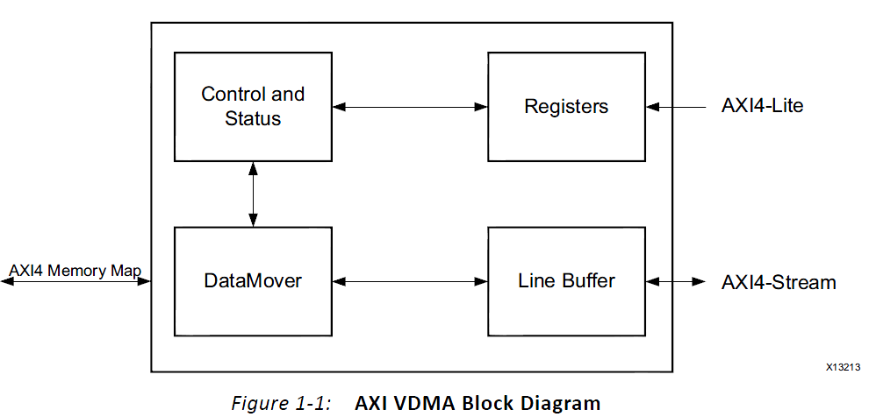
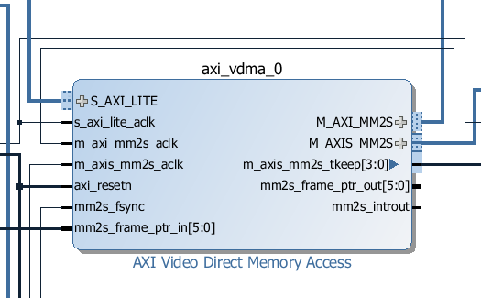
AXI Video Direct Memory Access v6.2 axi_vdma
Allow for efficient high-bandwidth access between the AXI4-Stream video interface and the AXI4 interface

Slide 15
Programming Sequence to configure and start with axi_vdma
1. Write control information to the channel VDMACR register to set interrupt enables if desired, and set VDMACR. RS=1 to start the AXI VDMA channel running.
2. Write a valid video frame buffer start address to the channel START_ADDRESS register 1 to N where N equals Frame Buffers.
dispPtr->FramePtr[i]=FramePtr[i];
3. Write a valid Frame Delay (valid only for Genlock Slave) and Stride to the channel FRMDLY_STRIDE register (Offset 0x58 for MM2S and 0xA8 for S2MM).
4. Write a valid Horizontal Size to the channel HSIZE register (Offset 0x54 for MM2S and 0xA4 for S2MM).
5. Write a valid Vertical Size to the channel VSIZE register (Offset 0x50 for MM2S and 0xA0 for S2MM). This starts the channel transferring video data.

Slide 16
Example Configuration of Zybo Base System Design: DisplayCtrl , vgaCtrl
typedef struct { //display_ctrl.h
u32 dispCtrlAddr; /*Physical Base address of the disp_ctrl core*/
/*flag indicating if the display controller is being used to drive an HDMI transmitter*/
int fHdmi;
XAxiVdma vdma; /*VDMA driver struct*/
XAxiVdma_DmaSetup vdmaConfig; /*VDMA channel configuration*/
VideoMode vMode; /*Current Video mode*/
/* Array of pointers to the framebuffers */
u32 *framePtr[DISPLAY_NUM_FRAMES];
u32 stride; /* The line stride of the framebuffers, in bytes */
double pxlFreq; /* Frequency of clock currently being generated */
u32 curFrame; /* Current frame being displayed */
DisplayState state; /* Indicates if the Display is currently running */
} DisplayCtrl;
DisplayCtrl hdmiCtrl;
DisplayCtrl vgaCtrl;
Current frame number to be displayed

Slide 17
XAxiVdma vdma in xaxivdma.h
/* The XAxiVdma driver instance data. */
typedef struct {
u32 BaseAddr; /**< Memory address for this device */
int HasSG; /**< Whether hardware has SG engine */
int IsReady; /**< Whether driver is initialized */
int MaxNumFrames; /**< Number of frames to work on */
int HasMm2S; /**< Whether hw build has read channel */
int HasMm2SDRE; /**< Whether read channel has DRE */
int HasS2Mm; /**< Whether hw build has write channel */
int HasS2MmDRE; /**< Whether write channel has DRE */
/**< Read Enable for video parameters in * direct register mode */
int EnableVIDParamRead;
int UseFsync; /**< DMA operations synchronized to Frame Sync */
int InternalGenLock; /**< Internal Gen Lock */
XAxiVdma_ChannelCallBack ReadCallBack; /**< Call back for read channel */
XAxiVdma_ChannelCallBack WriteCallBack; /**< Call back for write channel */
XAxiVdma_Channel ReadChannel; /**< Channel to read from memory */
XAxiVdma_Channel WriteChannel; /**< Channel to write to memory */
} XAxiVdma;

Slide 18
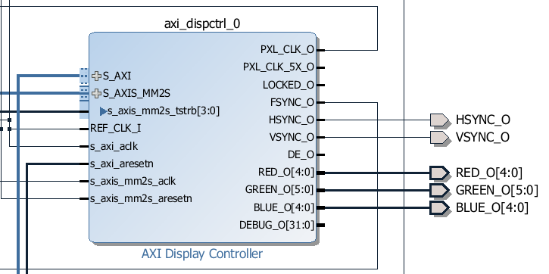
VGA Display Controller axi_dispctrl_v1-00_a from Digilent
S_AXI is connected to Zynq
S_AXIS_MM2S is connected to axi_vdma for data transfer
S_axis_mm2s_tstrb[3:0] is connected to m_axis_mm2s_tkkeep[3:0] axi_vdma
REF_CLK_I and s_axi_aclk are connected to FCLK_CLK0 of Zynq
PXL_CLK drives m_axis_mm2s_aclk
FSYNC is connected to mm2s_fsync of xi_vdma

Slide 19
DisplayDemoInitialize(): Initialize vgaCtrl in display_ctrl.c
dispPtr->curFrame = 0;
dispPtr->dispCtrlAddr = dispCtrlAddr;
dispPtr->fHdmi = fHdmi;
for (i = 0; i < DISPLAY_NUM_FRAMES; i++)
{
dispPtr->framePtr[i] = framePtr[i];
}
dispPtr->pxlFreq = 0;
dispPtr->state = DISPLAY_STOPPED;
dispPtr->stride = stride;
dispPtr->vMode = VMODE_640x480; //default

Slide 20
DisplayDemoInitialize(): Initialize VDMA driver in display_ctrl.c
int XAxiVdma_SetFrmStore(XAxiVdma *InstancePtr, u8 FrmStoreNum, u16 Direction)
FrmStoreNum - - the number of frame store buffers to use.
Direction - XAXIVDMA_READ/WRITE
Initialize the VDMA Read configuration struct
dispPtr->vdmaConfig.FrameDelay = 0;
dispPtr->vdmaConfig.EnableCircularBuf = 1;
dispPtr->vdmaConfig.EnableSync = 0;
dispPtr->vdmaConfig.PointNum = 0;
dispPtr->vdmaConfig.EnableFrameCounter = 0;

Slide 21
DisplayStart():
#define DISPLAYDEMO_MAX_FRAME (1920*1080)
#define DISPLAYDEMO_STRIDE (1920 * 4)
/ * Configure the VDMA to access a frame with the same dimensions as the current mode */
dispPtr->vdmaConfig.VertSizeInput = dispPtr->vMode.height;
dispPtr->vdmaConfig.HoriSizeInput = (dispPtr->vMode.width) * 4;
dispPtr->vdmaConfig.FixedFrameStoreAddr = dispPtr->curFrame;
/*Also reset the stride and address values, in case the user manually changed them*/
dispPtr->vdmaConfig.Stride = dispPtr->stride;
for (i = 0; i < DISPLAY_NUM_FRAMES; i++)
{
dispPtr->vdmaConfig.FrameStoreStartAddr[i] = (u32) dispPtr->framePtr[i];
}

Slide 22
DisplayStart():
/*Perform the VDMA driver calls required to start a transfer*/
Status = XAxiVdma_DmaConfig(&(dispPtr->vdma), XAXIVDMA_READ, &(dispPtr->vdmaConfig));
Status = XAxiVdma_DmaSetBufferAddr(&(dispPtr->vdma), XAXIVDMA_READ, dispPtr >vdmaConfig.FrameStoreStartAddr);
Status = XAxiVdma_DmaStart(&(dispPtr->vdma), XAXIVDMA_READ);
Status = XAxiVdma_StartParking(&(dispPtr->vdma), dispPtr->curFrame, XAXIVDMA_READ);

Slide 23
DisplayStart(): Configure VGA Display Controller to Start axi_vdma Transfer
/* Configure the disp_ctrl core with the display mode timing parameters */
vgaReg[0] = (dispPtr->vMode.width << 16) | (dispPtr->vMode.height);
vgaReg[1] = (dispPtr->vMode.hps << 16) | (dispPtr->vMode.hpe);
vgaReg[2] = (dispPtr->vMode.hpol << 16) | (dispPtr->vMode.hmax);
vgaReg[3] = (dispPtr->vMode.vps << 16) | (dispPtr->vMode.vpe);
vgaReg[4] = (dispPtr->vMode.vpol << 16) | (dispPtr->vMode.vmax);
for (i = 0; i < 5; i++)
{
Xil_Out32(dispPtr->dispCtrlAddr + OFST_DISPLAY_VIDEO_START + (i * 4), vgaReg[i]);
}
/*Enable the disp_ctrl core, which will signal the VDMA to begin transferring data*/
Xil_Out32(dispPtr->dispCtrlAddr + OFST_DISPLAY_CTRL,
(1 <<BIT_DISPLAY_START)); //FSYNC to start axi_vdma

Slide 24
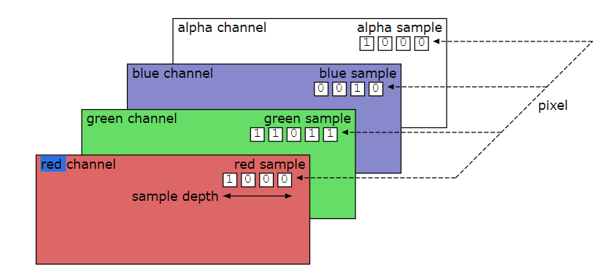
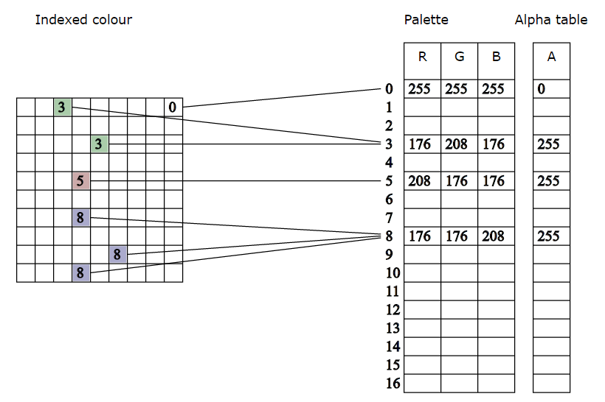
A Pixel in Portable Network Graphics (PNG) Specification
Alpha – a value to show a pixel’s degree of opacity
from 0 for transparent
to 1 for opaque
32-bit pixel color
8-bit Red
8-bit Green
8-bit Blue
8-bit Alpha
https://en.wikipedia.org/wiki/Alpha_compositing
https://www.w3.org/TR/PNG/

Slide 25
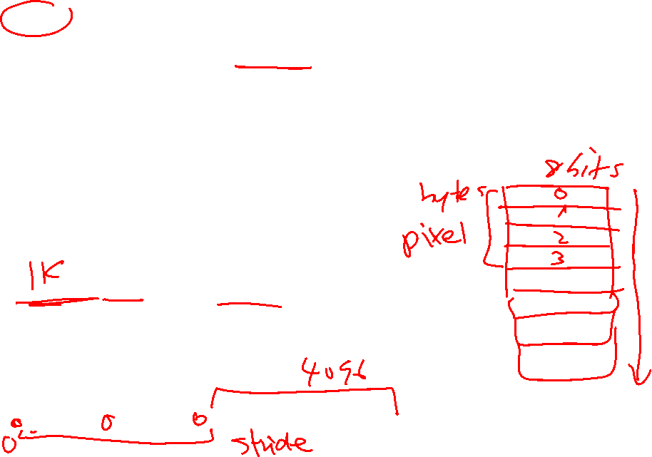
Stride of Frame Buffer Memory
Stride - This is the number of bytes between the start of one line and the start of another
Stride – The number of bytes for one line
#define DISPLAYDEMO_MAX_FRAME (1920*1080)
#define DISPLAYDEMO_STRIDE (1920 * 4) //1920 pixels and 4 bytes per pixel
Buffers in video ram generally have a stride (also called pitch) associated with them. The stride is the width of the buffer in bytes. For example, if you have a 1024x768 pixel buffer at 16 bits/pixel (2 bytes/pixel), your stride would be:
1024 pixels * 2 bytes/pixel = 2048 bytes
At 32 bits/pixel (4 bytes/pixel), your stride would be:
1024 pixels * 4 bytes/pixel = 4096 bytes
Stride is important as it delineates where each line of the buffer starts and ends. With a linear buffer format, each line of the buffer follows the previous linearly in video ram:
framebuffer address
0 2048 4096
|---------------|---------------|---------------| ... |---------------|

Slide 26
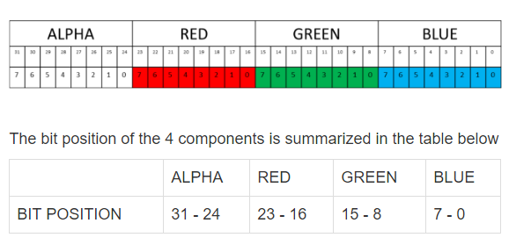
Pixel Color and Frame Definition in display_demo.c and display_demo.h
A pixel is composed of a 32-bit number: Alpha, Red, Green and Blue
//in vga_modes.h
static const VideoMode VMODE_800x600 = {
.label = "800x600@60Hz",
.width = 800,
.height = 600,
.hps = 840,
.hpe = 968,
.hmax = 1055,
.hpol = 1,
.vps = 601,
.vpe = 605,
.vmax = 627,
.vpol = 1,
.freq = 40.0
};
//In display_ctrl.h
#define BIT_DISPLAY_RED 16
#define BIT_DISPLAY_BLUE 0
#define BIT_DISPLAY_GREEN 8
AXI Video Direct Memory Access v6.2 pg020

Slide 27
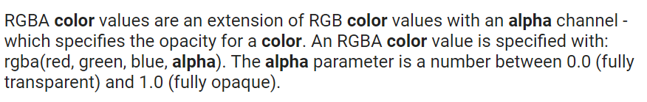
Pixel Color Packing
wColor is a 32-bit number for one pixel
//In display_ctrl.h
#define BIT_DISPLAY_RED 16
#define BIT_DISPLAY_BLUE 0
#define BIT_DISPLAY_GREEN 8
//Pixel Color Packing
wColor = ((u32) fRed << BIT_DISPLAY_RED) | ((u32) fBlue << BIT_DISPLAY_BLUE) | ( (u32) fGreen << BIT_DISPLAY_GREEN); }
AXI Video Direct Memory Access v6.2 pg020

Slide 28
Pixel Color and Frame Definition in display_demo.c and display_demo.h
32 bits per pixel
Byte packing
8 bits Alpha
8 bits RED
8 bits GREEN
8 bits BLUE
Stride = 800 pixels x 4 bytes = 3,200 bytes
The number of bytes per line
vMode.height=600
X=0
vMode.width=800
X=799
Y=0
800 pixels x 600 lines
3,200 bytes per line as each pixel takes 4 bytes
Y=599
AXI Video Direct Memory Access v6.2 pg020

Slide 29
Frame Buffer: u32 vgaBuf[3][1920*1080] – 4 bytes per pixel
//Framebuffers for each display device
#define DISPLAY_NUM_FRAMES 3
#define DISPLAYDEMO_MAX_FRAME 1920*1080
//u32 is 32-bit unsigned integer
u32 vgaBuf[DISPLAY_NUM_FRAMES][DISPLAYDEMO_MAX_FRAME]; //3 frames 1920x1080
Stored line by line in frame buffer memory
Pixels are stored in row by row order to make it easy to display one row at a time.
Each row will need the number of bytes equal to pixel bytes * number of pixels.
Stride is the number of bytes for one row.
The beginning address of a row is therefore equal to the beginning address of the previous row plus stride.
If stride = 800x4=3200, each starting address of frame buffer is N*stride, where N is row number:
0
3200
6400
0 1 stride-1
1xstride=3200 2*stride-1
2xstride=6400

Slide 30
How to Fill Each Column with the Same Color
wStride = stride/4; //stride = 3200 bytes, wStride=800 bytes
width=800; height=600;
for(xcoi = 0; xcoi < width; xcoi++) { //column by column
iPixelAddr = xcoi;
for(ycoi = 0; ycoi < height; ycoi++) { //row by row
frame[iPixelAddr] = wColor; //same 32-bit color
iPixelAddr += wStride; //32-bit address will increment by 4 bytes
}
}
iPixelAddr += wStride; //will increment iPixelAddr by 800x4 bytes
iPixelAddr
Ycoi=
0
1
.
.
579
0
3200
6400
0 1 stride-1
1xstride=3200 2*stride-1
2xstride=6400
Xcoi=0, 1, ….. 799

Slide 31
Color Generation: DISPLAYDEMO_PATTERN_1: 7 color bars
u32 vgaBuf[DISPLAY_NUM_FRAMES][DISPLAYDEMO_MAX_FRAME];
void DisplayDemoPrintTest(u32 *frame, u32 width, u32 height, u32 stride, int pattern)
//width = 800; height=600; stride=88x4;
{
u32 xcoi, ycoi;
u32 iPixelAddr;
u32 wStride;
u32 wRed, wBlue, wGreen, wColor;
u32 wCurrentInt;
double fRed, fBlue, fGreen, fColor;
u32 xLeft, xMid, xRight, xInt;
u32 yMid, yInt;
double xInc, yInc;
switch (pattern) //two patterns
Seven color bars = width/7=800/7=114
wStride=stride/4=800
Bar index:
xInt = width/7, number of pixels per bar
Color increment by 2 across pixels in one bar:
xInc is color index = 256/114=2
wCurrentInt is current bar number

Slide 32
Color Generation: DISPLAYDEMO_PATTERN_1: 7 Color Bars
Divide the screen into 7 vertical bars for 114 pixels per bar
Each bar has 800/7=114 pixels
Bar 1 is red only; Bar 2 is blue only and Bar 4 is green only
8-bit Color (0-255) is divided with the number of pixels in one bar
256/114=2
Initial color is 0 and is incremented by 2 as pixel increases from 0 to 113
Each pixel in one column will get the same color
114 pixels per bar
Bar | 1 | 2 | 3 | 4 | 5 | 6 | 7
Red | ON |  | ON |  | ON |  | ON
Blue |  | ON | ON |  |  | ON | ON
Green |  |  |  | ON | ON | ON | ON
Bar color intensity is from 0 to 226

Slide 33

Color Generation: DISPLAYDEMO_PATTERN_1
Bar | 1 | 2 | 3 | 4 | 5 | 6 | 7
Red | ON |  | ON |  | ON |  | ON
Blue |  | ON | ON |  |  | ON | ON
Green |  |  |  | ON | ON | ON | ON
Bar color intensity increases from 0 to 226 within one bar
114 pixels per bar
114*7=800 pixels per line

Slide 34
Color Generation: DISPLAYDEMO_PATTERN_1
case DISPLAYDEMO_PATTERN_1:
wStride = stride / 4; /* Find the stride in 32-bit words */
xInt = width / 7; //Seven intervals, each with width/7 pixels; seven color bars 800/7
//256 color intensities per interval. Notice that overflow is handled for this pattern.
xInc = 256.0 / ((double) xInt); //color change based on bar number
fColor = 0.0;
wCurrentInt = 1; //current bar from 1 to 7
for(xcoi = 0; xcoi < width; xcoi++) //column by column, width == number of pixels=800
{
if (wCurrentInt & 0b001) fRed = fColor; else fRed = 0.0; //red for bar 1
if (wCurrentInt & 0b010) fBlue = fColor; else fBlue = 0.0; //blue for bar 2
if (wCurrentInt & 0b100) fGreen = fColor; else fGreen = 0.0; //green for bar 4
/* Just draw white in the last partial interval (when width is not divisible by 7) */
if (wCurrentInt > 7) { wColor = 0x00FFFFFF; } //32 bit color per pixel
else {
wColor = ((u32) fRed << BIT_DISPLAY_RED) | ((u32) fBlue << BIT_DISPLAY_BLUE) | ( (u32) fGreen << BIT_DISPLAY_GREEN); } //color packing
iPixelAddr = xcoi;
// all column will have the same color; height is from 0 to 600
for(ycoi = 0; ycoi < height; ycoi++) { frame[iPixelAddr] = wColor;
/* This pattern is printed one vertical line at a time, so the address must be incremented
* by the stride instead of just 1. */
iPixelAddr += wStride; //address
}
AXI Video Direct Memory Access v6.2 pg020

Slide 35
Color Generation: DISPLAYDEMO_PATTERN_1
fColor += xInc;
if (fColor >= 256.0)
{
fColor = 0.0;
wCurrentInt++;
}
}
/*
* Flush the framebuffer memory range to ensure changes are written to the
* actual memory, and therefore accessible by the VDMA.
*/
Xil_DCacheFlushRange((unsigned int) frame, DISPLAYDEMO_MAX_FRAME * 4);
break;
//copy temporary frame to display frame.

Slide 36
A Better Way to Assign Color with switch statement
Switch statement is much better to describe more than two options.
Compare the if statements and switch statement below, which implement the same function.
if (wCurrentInt & 0b001) fRed = fColor; else fRed = 0.0; //red for bar 1
if (wCurrentInt & 0b010) fBlue = fColor; else fBlue = 0.0; //blue for bar 2
if (wCurrentInt & 0b100) fGreen = fColor; else fGreen = 0.0; //green for bar 4
switch(wCurrentInt) {
case 0b000: {fGreen = 0.0; fBlue = 0.0; fRed = 0.0; break;}
case 0b001: {fGreen = 0.0; fBlue = 0.0; fRed = fColor; break;}
case 0b010: {fGreen = 0.0; fBlue = fColor; fRed = 0.0; break;}
case 0b011: {fGreen = 0.0; fBlue = fColor; fRed = fColor; break;}
case 0b100: {fGreen = fColor; fBlue = 0.0; fRed = 0.0; break;}
case 0b101: {fGreen = fColor; fBlue = 0.0; fRed = fColor; break;}
case 0b110: {fGreen = fColor; fBlue = fColor; fRed = 0.0; break;}
case 0b111: {fGreen = fColor; fBlue = fColor; fRed = fColor; break;}
default: {fGreen = 0.0; fBlue = 0.0; fRed = 0.0; break;}
}

Slide 37

Tweetable Mathematical Art Design Competition
https://codegolf.stackexchange.com/questions/35569/tweetable-mathematical-art.
Write 3 Tweetable (meaning 140 characters or less) function bodies for the red, green and blue values for a 1024x1024 image
Twitter (/ˈtwɪtər/) is an online news and social networking service where users post and interact with messages, "tweets," restricted to 140 characters. Registered users can post tweets.
AXI Video Direct Memory Access v6.2 pg020

Slide 38
Tweetable Mathematical Art Design Competition: C++ Code
Write 3-byte pixel color into a file.
// NOTE: compile with g++ filename.cpp -std=c++11
// also, if this doesn't work for you, try the alternate char-based version
#include <iostream>
#include <cmath>
#define DIM 1024
#define DM1 (DIM-1)
#define _sq(x) ((x)*(x)) // square
#define _cb(x) abs((x)*(x)*(x)) // absolute value of cube
#define _cr(x) (unsigned short)(pow((x),1.0/3.0)) //cube root
unsigned short RD(int i, int j){
// YOUR CODE HERE
}
unsigned short GR(int i,int j){
// YOUR CODE HERE
}
unsigned short BL(int i,int j){
// YOUR CODE HERE
}
void pixel_write(int,int);
FILE *fp;
int main(){
fp = fopen("MathPic","wb");
fprintf(fp, "P6\n%d %d\n1023\n", DIM, DIM);
for(int j=0;j<DIM;j++)
for(int i=0;i<DIM;i++)
pixel_write(i,j);
fclose(fp);
return 0;
}
void pixel_write(int i, int j){
static unsigned short color[3];
color[0] = RD(i,j)&DM1;
color[1] = GR(i,j)&DM1;
color[2] = BL(i,j)&DM1;
fwrite(color, 2, 3, fp);
}

Slide 39
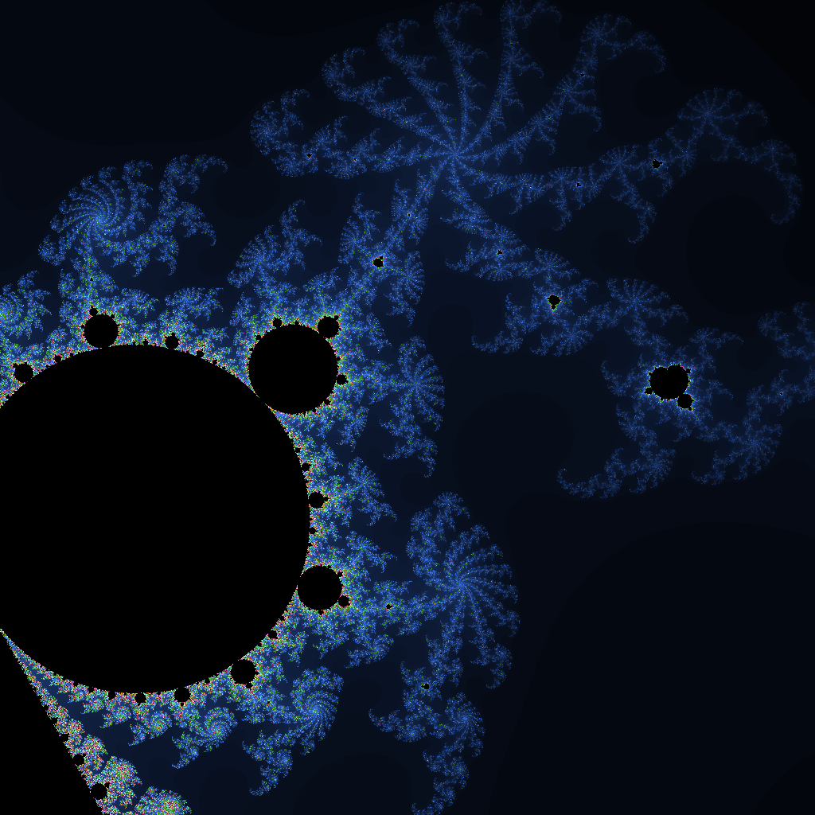
Tweetable Mathematical Art Design Competition: Mandelbrot 132 chars
unsigned char RD(int i,int j){
double a=0,b=0,d,n=0;
for(;a*a+(d=b*b)<4&&n++<8192;b=2*a*b+j/5e4+.06,a=a*a-d+i/5e4+.34); return n/4; }
unsigned char GR(int i,int j){ return 2*RD(i,j); }
unsigned char BL(int i,int j){ return 4*RD(i,j);
}

Slide 40

Tweetable Mathematical Art Design Competition: Ripple in Motion
unsigned char RD(int i,int j){
#define P 6.03
float s=3./(j+250),y=(j+sin((i*i+_sq(j-700)*5)/100./DIM+P)*15)*s;return (int((i+DIM)*s+y)%2+int((DIM*2i)*s+y)%2)*127;}
unsigned char GR(int i,int j){
float s=3./(j+250);
float y=(j+sin((i*i+_sq(j-700)*5)/100./DIM+P)*15)*s;
return (int(5*((i+DIM)*s+y))%2+int(5*((DIM*2-i)*s+y))%2)*127;}
unsigned char BL(int i,int j){
float s=3./(j+250);
float y=(j+sin((i*i+_sq(j-700)*5)/100./DIM+P)*15)*s;
return (int(29*((i+DIM)*s+y))%2+int(29*((DIM*2-i)*s+y))%2)*127;}

Slide 41

Tweetable Mathematical Art Design Competition: Julia sets
unsigned short red_fn(int i, int j){
#define D(x) (x-DIM/2.)/(DIM/2.)
float x=D(i),y=D(j),X,Y,n=0;while(n++<200&&(X=x*x)+(Y=y*y)<4){x=XY+.36237;y=2*x*y+.32;}return log(n)*256;}
unsigned short green_fn(int i, int j){
float x=D(i),y=D(j),X,Y,n=0;while(n++<200&&(x*x+y*y)<4){X=x;Y=y;x=X*X-Y*Y+.7;y=2*X*Y+.27015;}return log(n)*128;}
unsigned short blue_fn(int i, int j){
float x=D(i),y=D(j),X,Y,n=0;while(n++<600&&(x*x+y*y)<4){X=x;Y=y;x=X*XY*Y+.36237;y=2*X*Y+.32;}return log(n)*

Slide 42
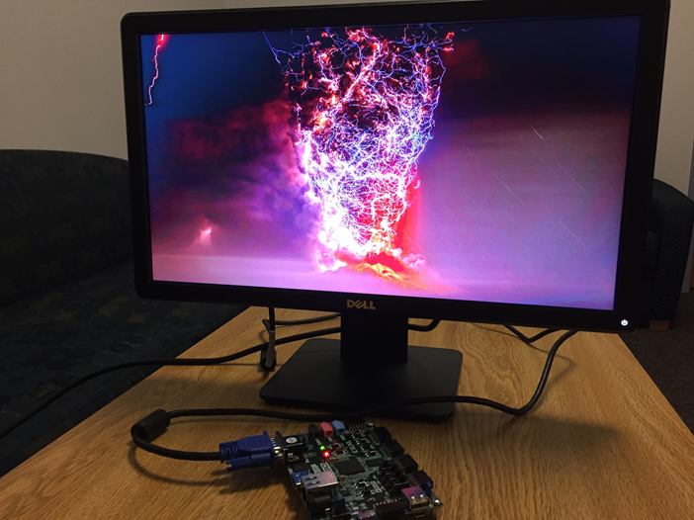
An Image of 1920x1080 Pixels by Rick Rung, CPE 2018

Slide 43
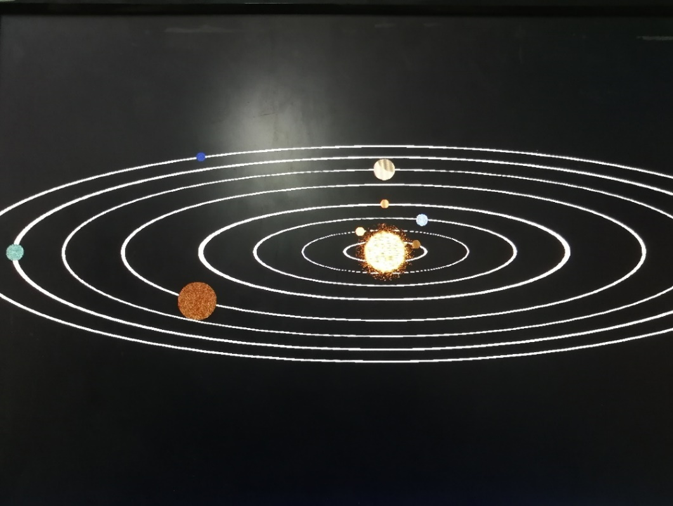
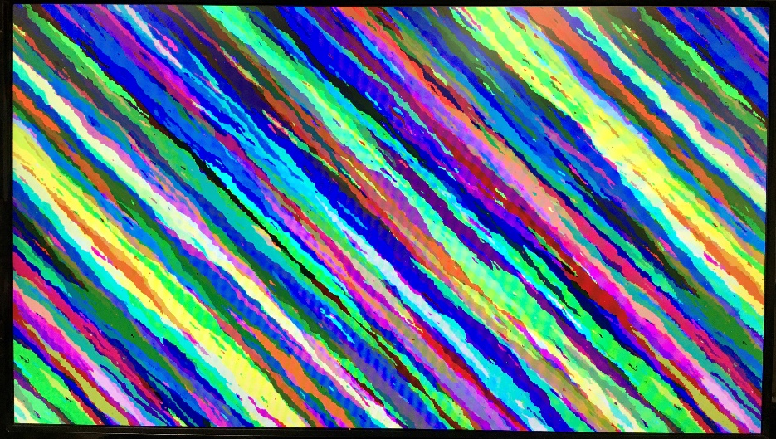
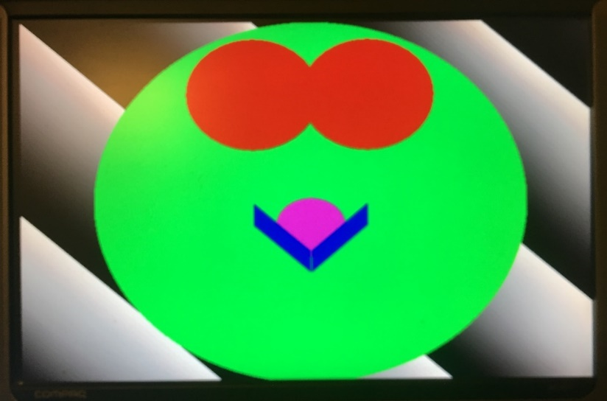
Other Images from Students of Huazhong U of Science and Technology

